Slide 1
Introduction to Repositories & Git
Foundation for Modern Apps
Amit Rathod
March 2021

Slide 2



Introduction
History
Basic Commands
Advanced Topics
Registries

Slide 3
Introduction

Slide 4

Presentation and Playbook
Go grab a copy of the presentation and playbook to follow along
The playbook contains steps and commands we will be using
https://github.com/amitrathod101/tambootcamp-git
https://gitlab.eng.vmware.com/arathod/tam-modern-apps

Slide 5
Goals
Fork
Introduce you to modern source control systems
Understand basic commands
Explore advanced concepts
Leverage labs for hands-on experience
Rebase
Add
Clone
Merge
Commit
Push
Pull

Slide 6
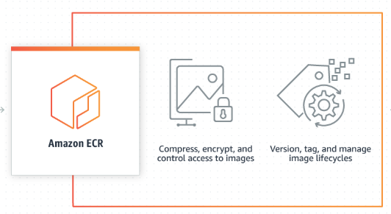
For Today’s Discussion...
Source code repository
Version control for related objects
Container image registry
Service that stores your container images
Repository
Registry

Slide 7
History

Slide 8
190 Million
October 2007
Microsoft
100 Million
40 Million

Slide 9

Software Development Lifecycle
Multiple developers working on a project
Project source code is maintained in a repository
Developers work both independently and collaboratively
Merge your changes along with everyone else
Builds occur out of the common branch
Need for:
File Locking
Versioning
Labels, Tags

Slide 10
Traditional Version Control Software
Client-Server model
On-premise
Developers use a shared, single repository
RCS – Revision Control System
SCCS – Source Code Control System
IBM Rational ClearCase
Microsoft Visual SourceSafe
CVS – Concurrent Versions System
Attributes
Examples

Slide 11
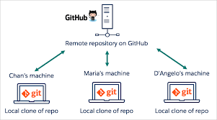
Modern Source Control
SaaS based tools
Distributed version control system
Developer centric tools
Lightweight for agile development
Optimized for local development
Branches are lightweight and cheap

Slide 12
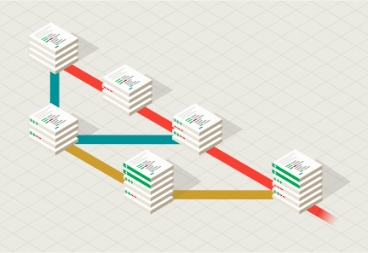
GIT
GIT – an offensive English slang term for “a stupid person
Created in 2005 by Linus Torvalds (who also developed Linux Kernel)
Free open-source software that handles source code versioning
Track local file changes
Share changes with a remote repository
Most widely used modern version control system
https://git-scm.com/

Slide 13
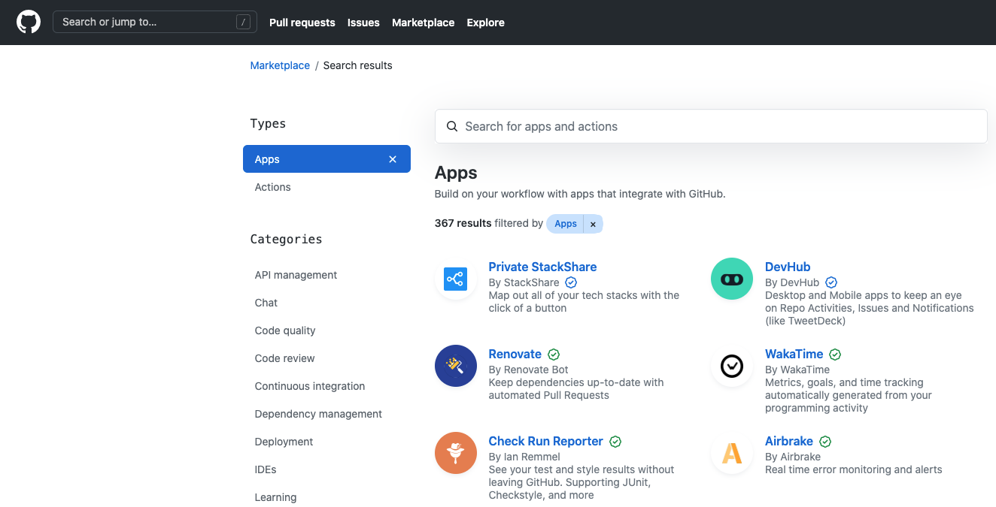
GitHub
Web-based GIT repository for projects
Cloud service for remote hosting of git repositories
Helps manage software development projects
Free services for open source projects
Paid services for private projects
Handles bug tracking, feature requests, task management, wiki's, etc
https://github.com

Slide 14
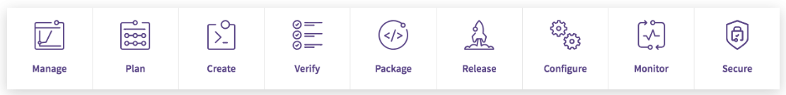
Gitlab
Web-based git repository
Cloud service for public projects
Paid service for private projects
Good at managing the DevOps lifecycle with tools such as Jira, CI runner, release mgmt
Popular due to seamless integration with CI/CD (Continuous Integration) technologies
“Top-of-the-line kitchen for making software”
https://gitlab.com

Slide 15
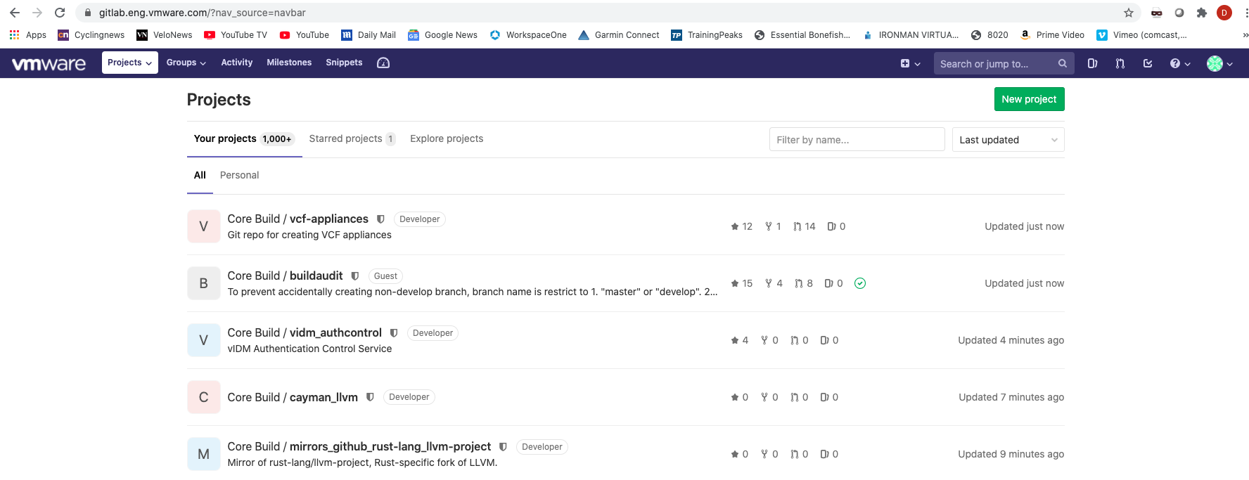
Gitlab at VMware
VMware uses GitLab and has a corporate account
gitlab.eng.vmware.com
We will be using gitlab internal for our learning

Slide 16
Bitbucket
Web-based version control repository
Uses Git or Mercurial revision control systems
Per-user pricing
On-premise hosting with Bitbucket Data Center
CI/CD integration
www.bitbucket.org

Slide 17
Basic Commands

Slide 18
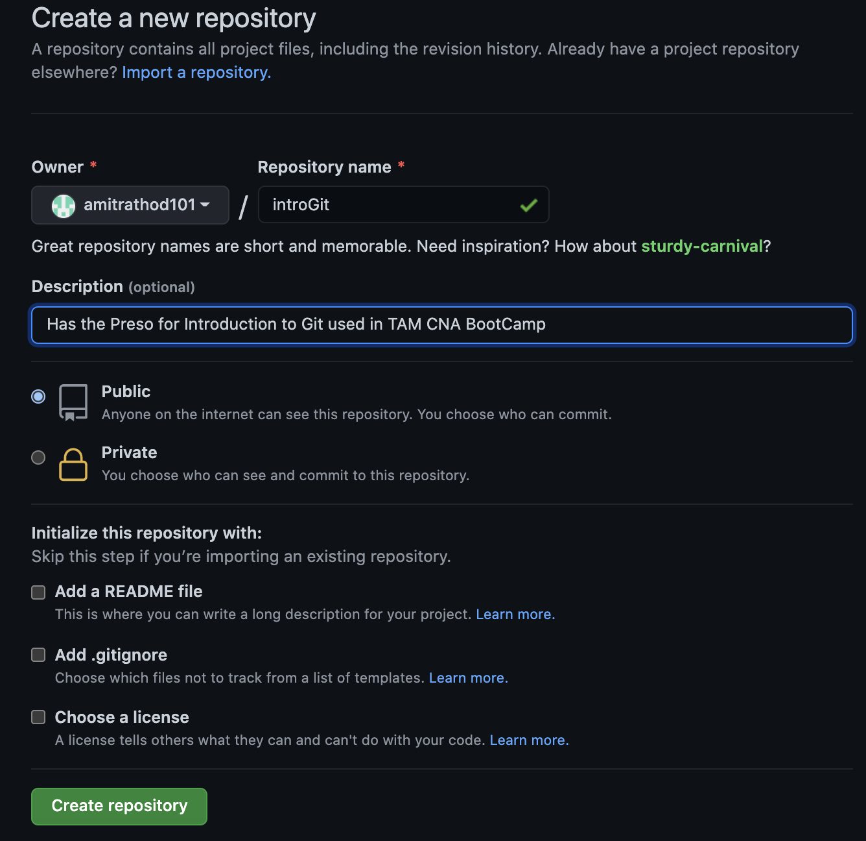
Create a GitHub Repository

Slide 19
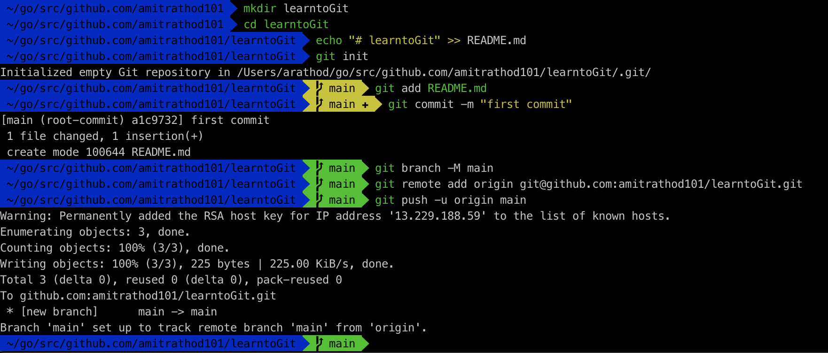
Create Repo - continued

Slide 20
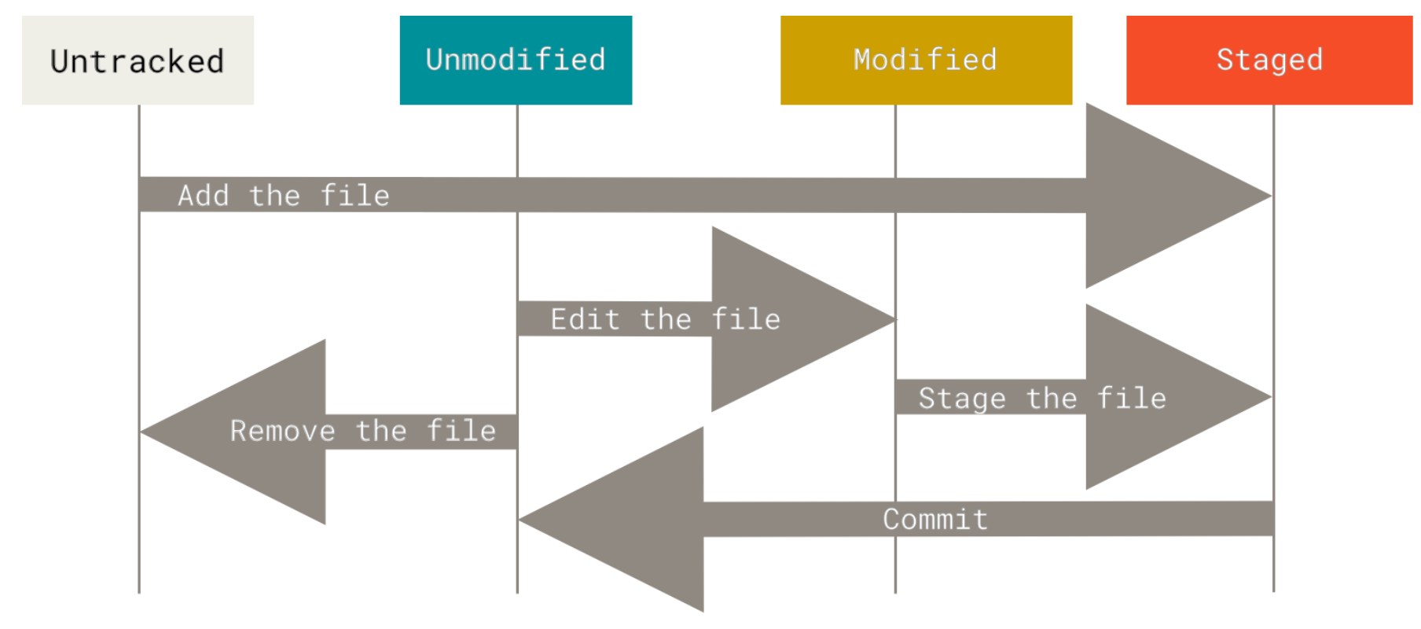
Lifecycle of Files in Git

Slide 21

Add/Commit/Push
ADD
COMMIT
PUSH

Slide 22
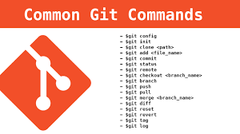
Core Commands
Basic commands you use every day
Git clone username@host:/path/to/repository
Copy a repository
Git add
Add files to the staging area
Git commit
Create a snapshot of the changes and save it to the git directory
Git push
Send local commits to the master branch of the remote repository
Git pull
Merge all changes present in the remote repository to the local working directory
Git restore
Restore a previous version of a file from the repository
Git status
Displays the list of changed files together with the files that are yet to be staged or committed
Git help
Command line help

Slide 23
Other Commands
Git init
Create a new local GIT repository
Git remote
View all remote repositories
Git checkout
Creates branches and helps you to navigate between them
Git fork
A copy of a repository
Git branch
List, create, or delete branches

Slide 24
Advanced Topics

Slide 25
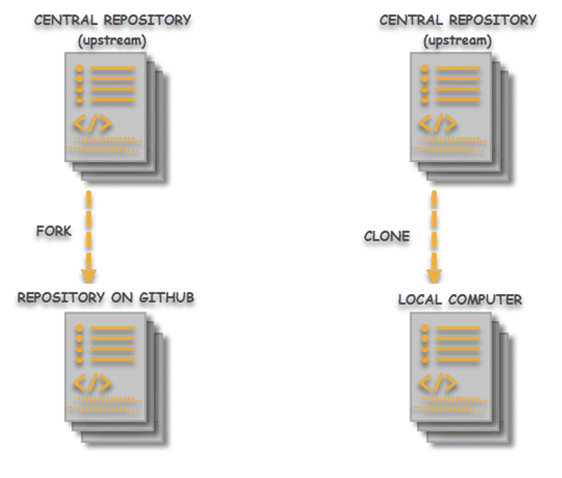
Git Clone vs Git Fork
CLONE
FORK
- Creates a local copy of a repository
- Takes the repository and puts it into a folder with the name of the repository
- Gets changes made by the parent via pull/rebase
- Allows easy push and merge with parent
- Creates a new repository with the “forked” code
- You then clone from the fork
- Does not get any changes made by the parent,
- AWS fork of ElasticSearch/Kibana is an example
https://aws.amazon.com/blogs/opensource/stepping-up-for-a-truly-open-source-elasticsearch/

Slide 26
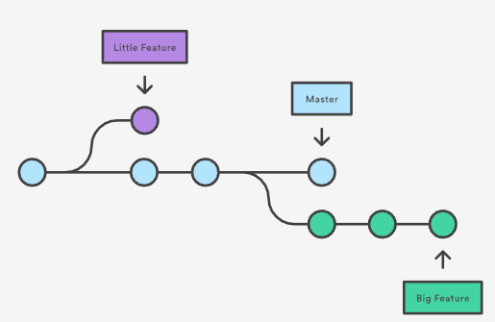
Branches
- Branches are part of the development process
- You create a branch when fixing a bug or adding a feature
- A branch represents an independent line of development
- git branch works on local and remote branches
- git checkout allows you to create and switch to a branch

Slide 27
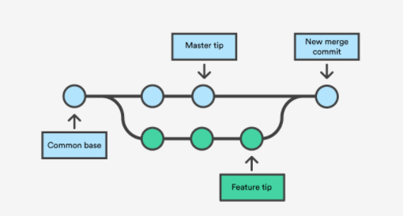
Merging
- takes a branch and merges changes with the parent
- git shows you both versions (branch and parent) and lets you decide which changes/conflicts to accept

Slide 28
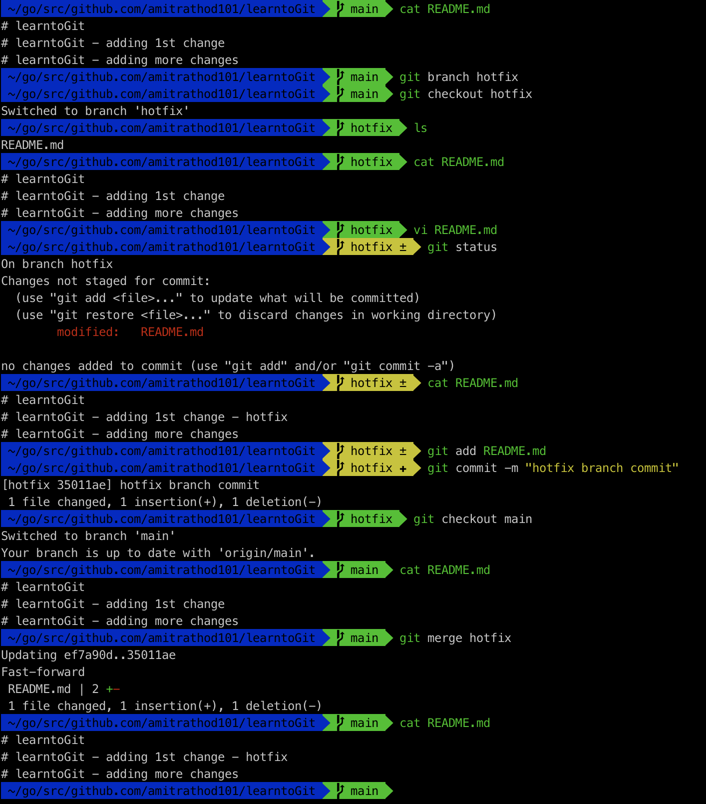
Merging hotfix branch to main

Slide 29
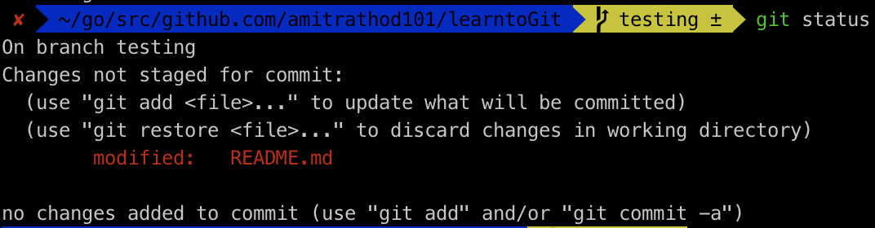
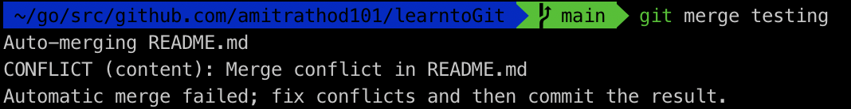
Branch Merge Conflict – between hotfix and testing
Edited the same line on README.md , where a change was made in the hotfix branch
Do the git add and git commit and git push in the testing branch and then switch to main branch
Merge the testing branch to main

Slide 30
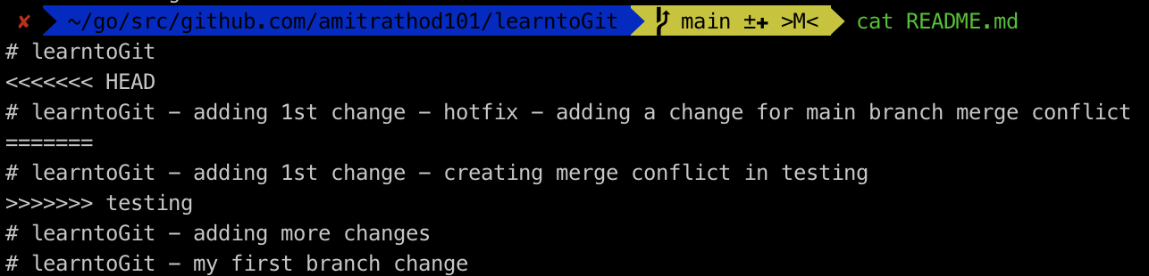
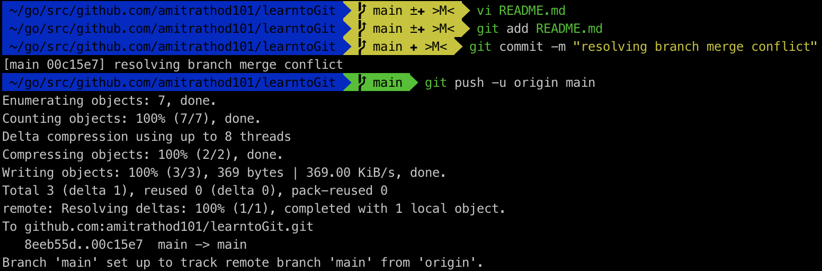
Resolving Branch merge conflict
Now to resolve that conflict we will have to look into the contents of the README.md file
Apart from keeping or deleting the text lines, you would also want to remove those <<< HEAD and >>>> testing from the file and save it.

Slide 31
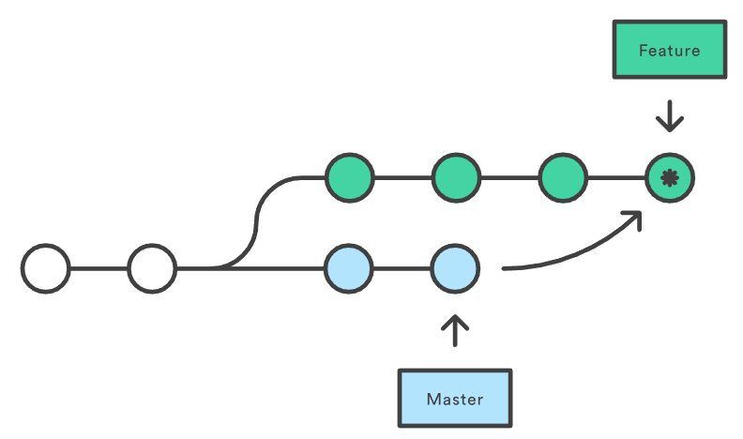
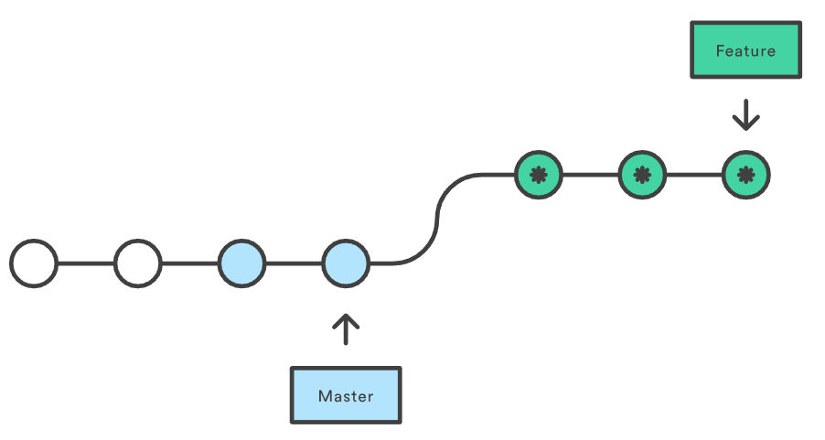
Git Pull vs Git Rebase
PULL
REBASE
- Fetches the latest changes of the current branch
- Applies those changes to your local copy
- Local changes are “merged” with the remote changes
- Same as git fetch/git merge
- Non-destructive (existing branches are not changed in any way
- Combines two branches
- Moves one branch on top of the other
- Moves all changes in ”feature” branch into the “main” branch
- You lose project history
https://www.atlassian.com/git/tutorials/merging-vs-rebasing

Slide 32

Git Profiles
Git comes with a config tool
Generally, config is stored in $HOME/.gitconfig
Can be used with the % git config command
Use to set your identity
Use to identify your “ignore” file
Things you can set in your profile
Default branch
Colors
Editor
https://git-scm.com/docs/git-config
% cat .gitconfig
# This is Git's per-user configuration file.
[user]
name = Amit Rathod
email = arathod@vmware.com
[core]
excludesfile = /Users/arathod/.gitignore_global

Slide 33
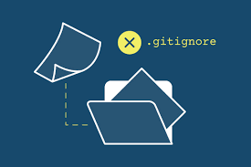
Git Ignore
Specifies intentionally untracked files to ignore
Each line specifies a pattern
Helps make sure you do not push
Credentials
Log files
Generally, resides in your $HOME directory
Can be specified in your .gitprofile
Create one of these as a “best practice”
https://git-scm.com/docs/gitignore
% cat .gitignore_global
*~
.*.swp
.DS_Store
**/_output/*
**/credentials-s3/*

Slide 34
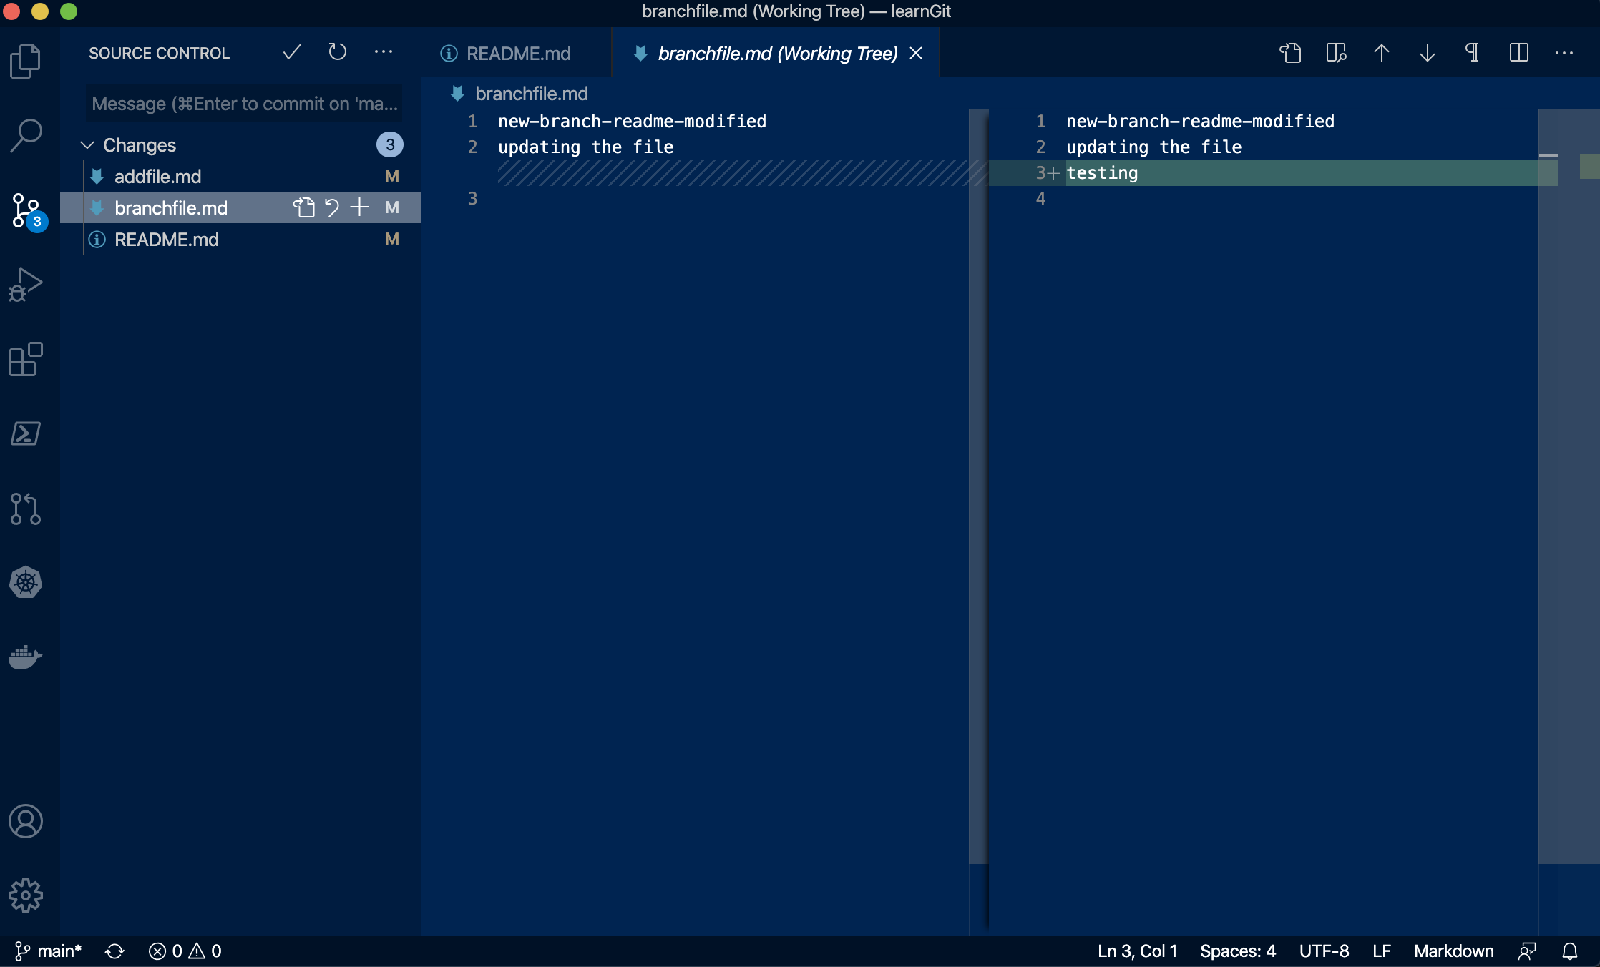
Microsoft Visual Studio Code
Visual Studio Code
IDE (Integrated Development Environment)
Integrated source control
Plugins for
Git
Docker
Kubernetes
Markdown
JSON
Yaml
Allows you to perform Git actions from the IDE

Slide 35

Additional Resources
Git Cheat Sheet
https://training.github.com/
Git Command Reference
https://git-scm.com/docs
Git Training
https://githubtraining.github.io/training-manual/#/02_getting_started
https://www.atlassian.com/git/tutorials/learn-git-with-bitbucket-cloud

Slide 36
Modern Registries

Slide 37
Docker Hub
Create, manage and deliver container images
World’s largest community for container images
Integration with the development pipeline
100,000+ container images
https://hub.docker.com/

Slide 38
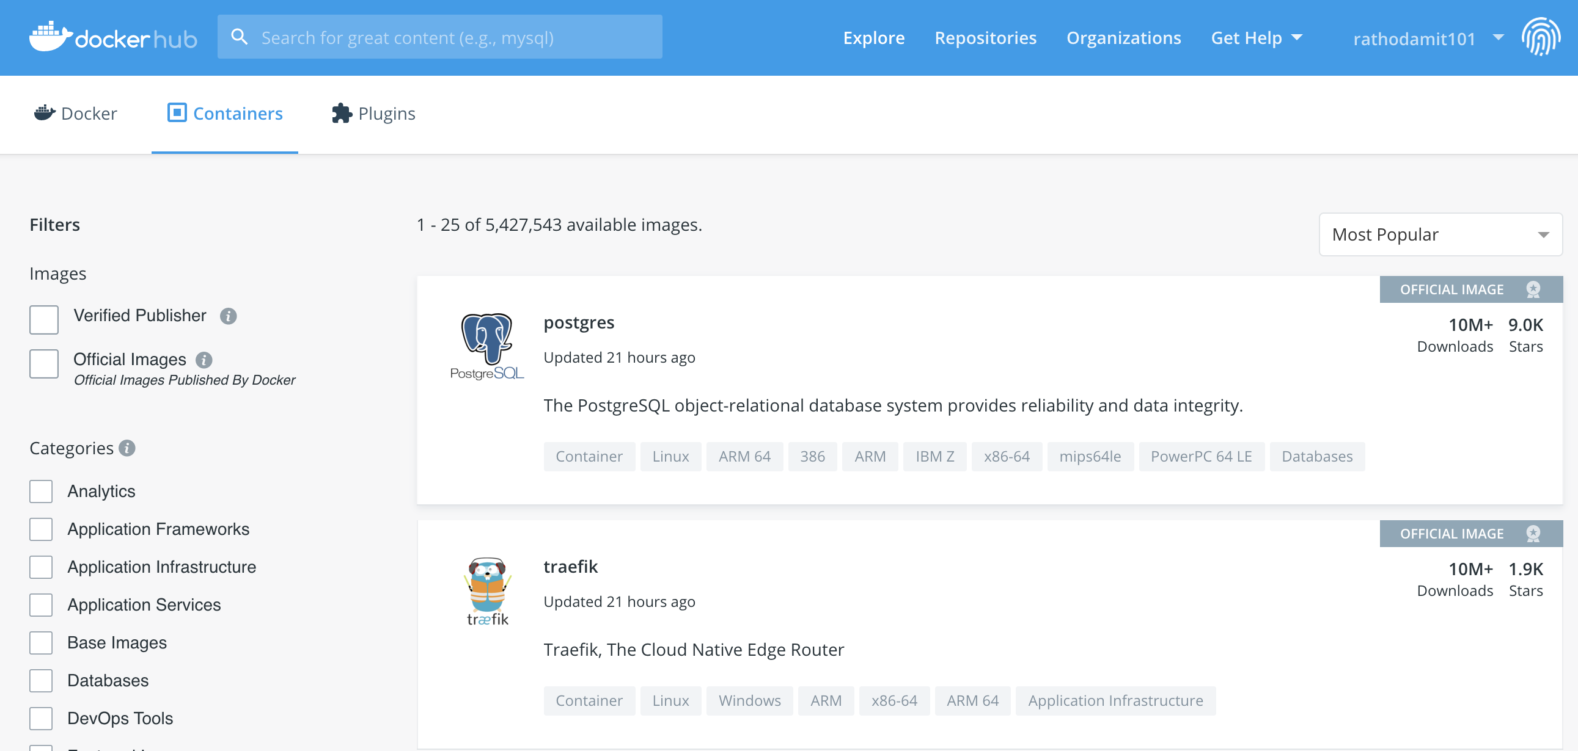
Docker Hub Examples

Slide 39
The Big Three
Amazon ECR
Google Container Registry
Azure Container Registry
Fully-manages Docker container registry
Store, manage and deploy Docker container images
Integrated with ECS (Elastic Container Service)
Highly available, highly scalable
Pay for the amount of data you store in your repository
Secure, private docker registry on GCP
Integration with github
Regional private repositories on GCP
Native Docker support
Extensible architecture for CI/CD
Build, store, secure, scan and manage container images
Supports Docker, Azure Kubernetes Service and RedHat OpenShift
Geo-replication

Slide 40
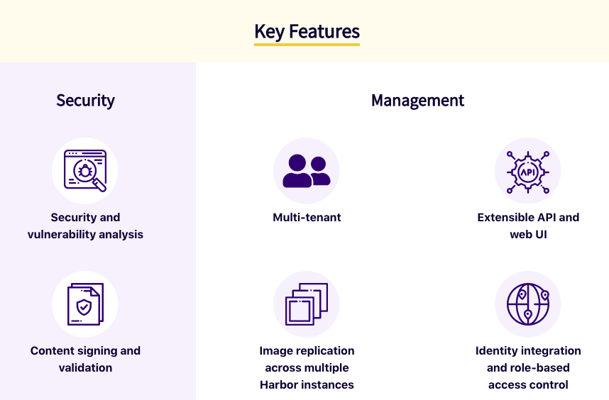
Harbor
Open source container image registry
Started by VMware in 2014
Role-based access control
Included as part of all Tanzu releases
Replication of images across registries
REST API
https://goharbor.io/

Slide 41
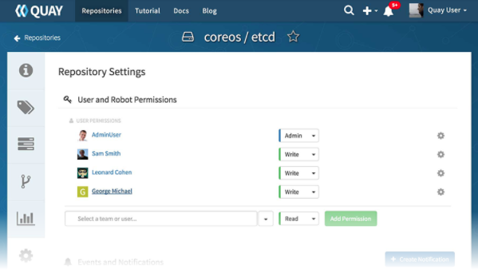
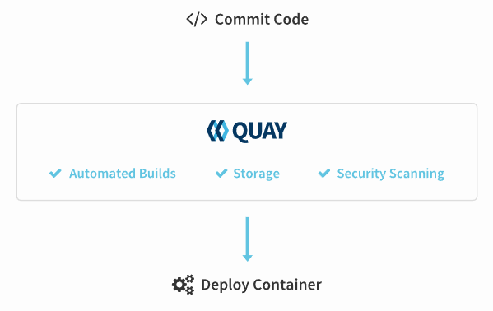
Quay / Quay.io
Container registry
Founded in 2012
Sold and hosted by Red Hat
Hosted in cloud or on-prem
Integration with GitHub, Gitlab, BitBucket
Quay – Red Hat’s on-prem registry
Quay.io - Red Hat’s hosted service registry
Projectquay.io is the opensource distribution that powers Red Hat Quay and Quay.io

Slide 42
LAB

